Slide 1
Human-Controlled Fuzzing with AFL
Maxim Grishin
Igor Korkin
2022

Slide 2


WHO WE ARE
Maxim Grishin
Bachelor of Information Security
National Research Nuclear University MEPhI
Cryptology and Cybersecurity Department
Igor Korkin, PhD
Independent Security Researcher
Speaker at CDFSL, BlackHat, HITB, SADFE
sites.google.com/site/igorkorkin

Slide 3
AGENDA
Fuzzing and classification of fuzzers
The main fuzzing strategy
Fuzzing with AFL. The problem of analyzing identical code sections
The proposed tool. The algorithm and details of the work
Execution traces registration
Test results
Future plans

Slide 4



WHAT IS FUZZING?
Fuzzing is a technique of automated testing when a program receives specially modified, incorrect data.

Slide 5
Fuzzers
Fuzzing goal
Input data receiving
Input data info
Network protocols
Generation
OS Kernel
Mutation
Drivers
White-box
Combined
Web App
Grey-box
Local App
Black-box

Slide 6

FUZZING STRATEGY
Source code
Input_1
Attack surface
Static analysis
Input_2
minimization
Input_2
Input_3
Input_3
Input_4
vulnerabilities list
Crash report
Сlassifier
AFL
program

Slide 7
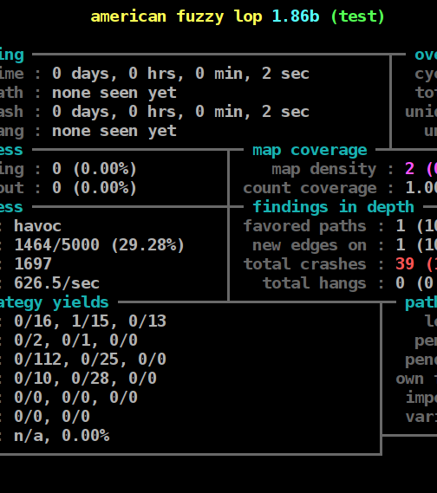

American Fuzzy Lop

Slide 8
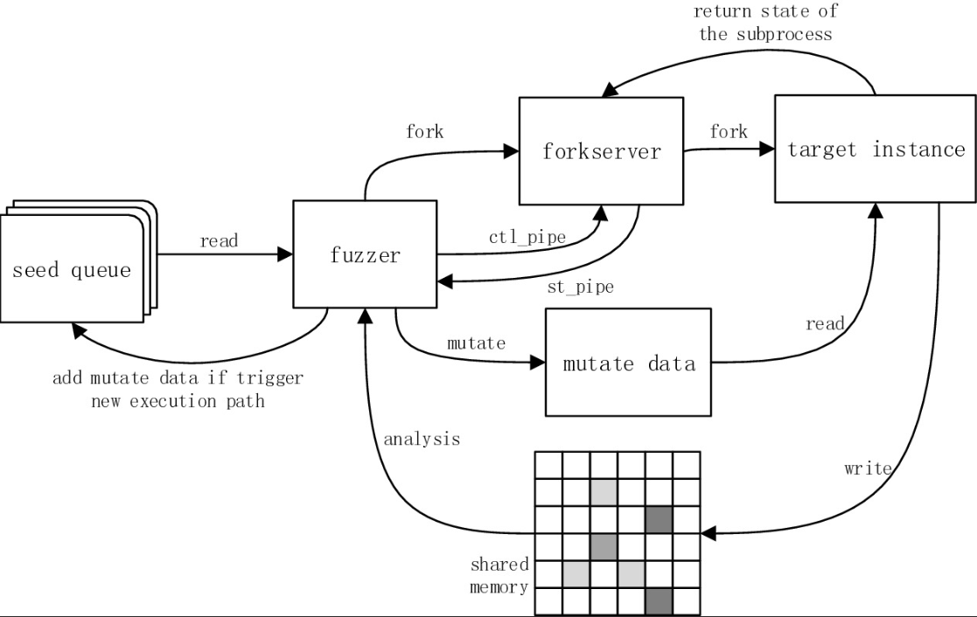
AFL – PROCESS STANDARD CYCLE

Slide 9
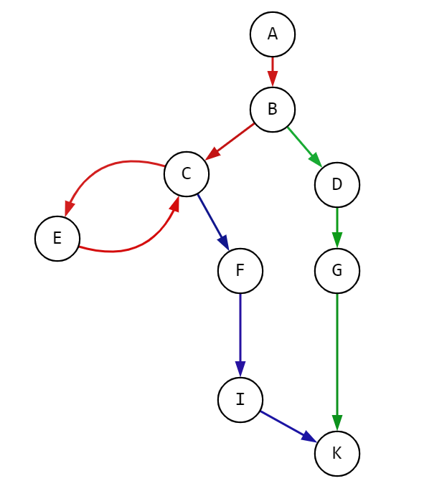
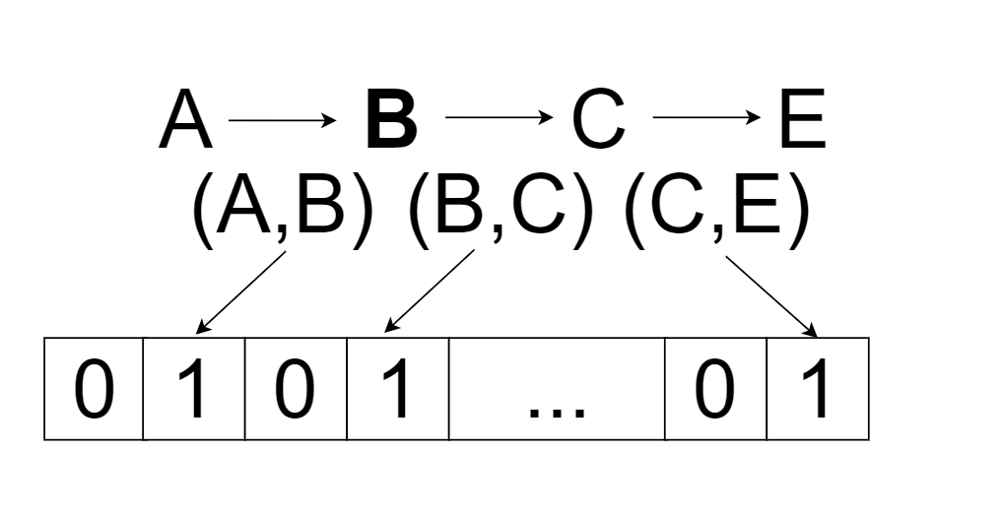
EXECUTION TRACE

Slide 10

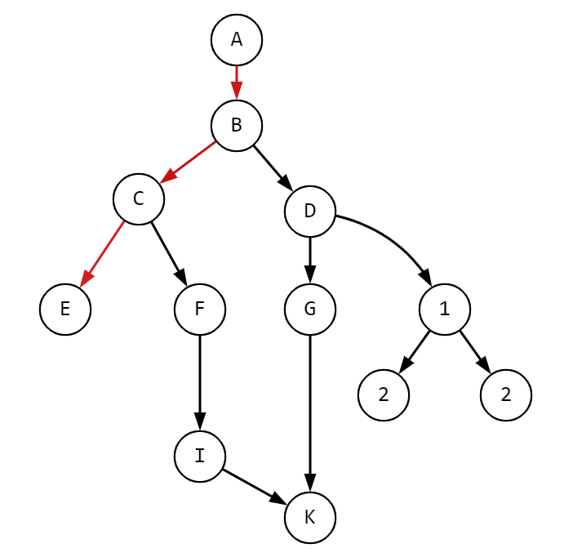
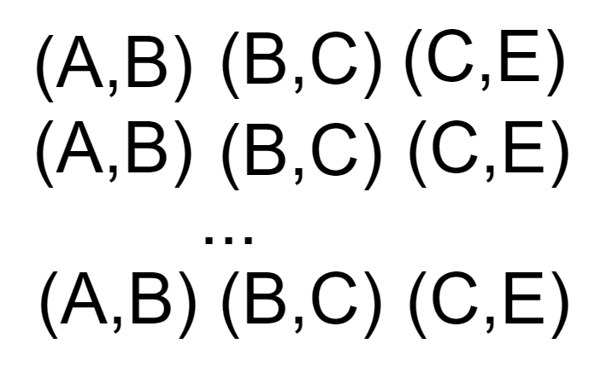

Slide 11
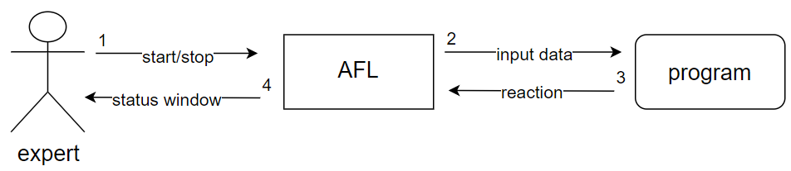
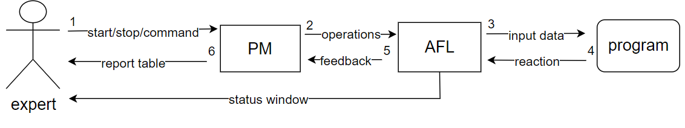
Classic AFL scheme
Proposed fuzzing system scheme

Slide 12
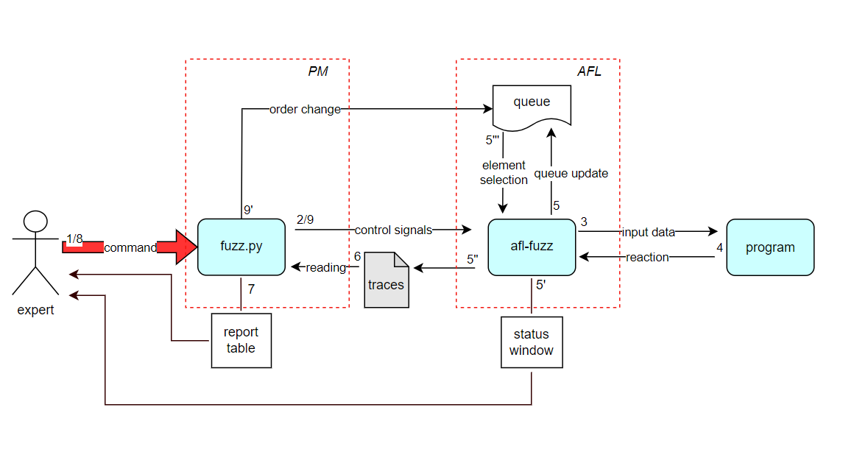

Slide 13
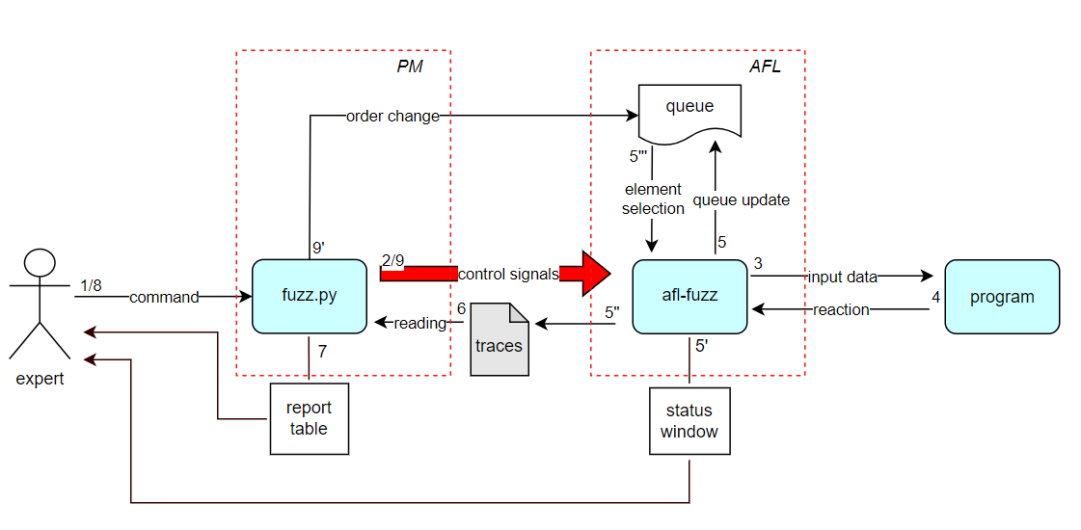

Slide 14
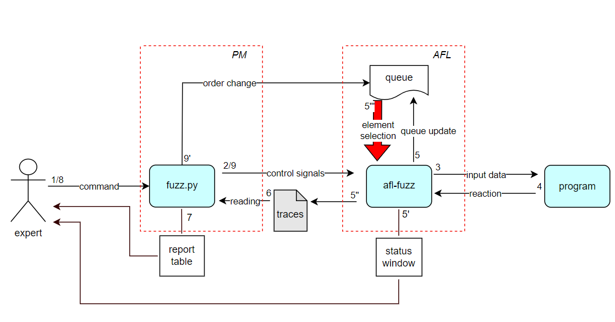

Slide 15
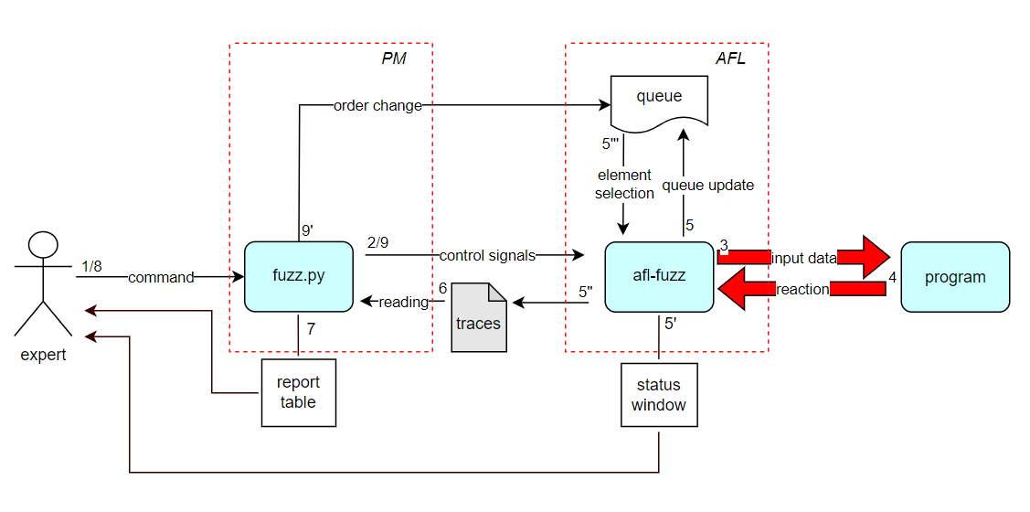

Slide 16
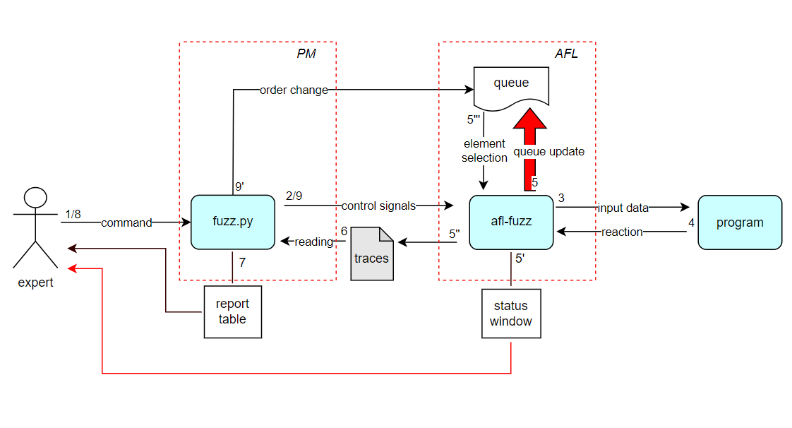

Slide 17
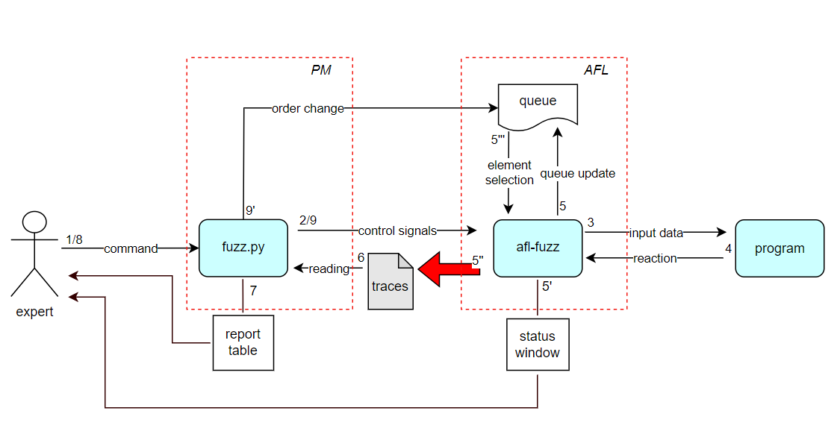

Slide 18
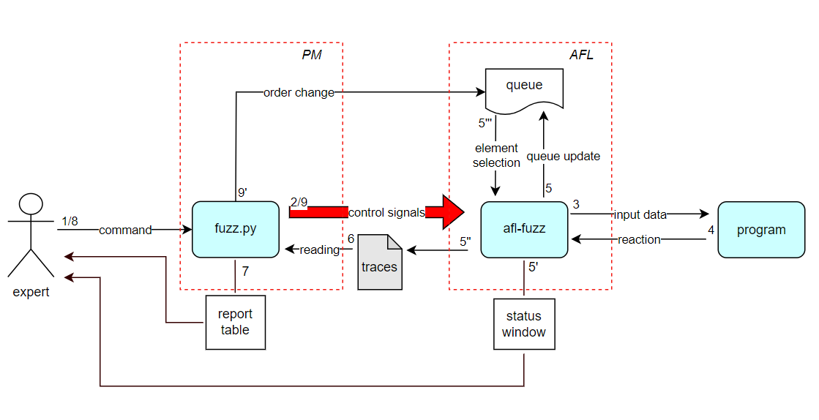

Slide 19
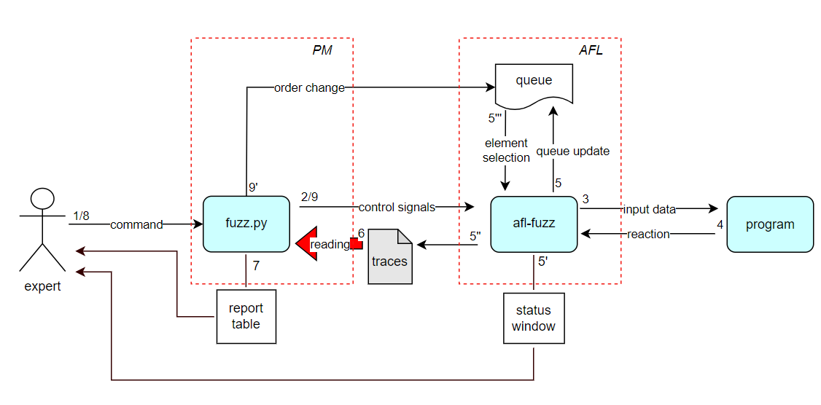

Slide 20
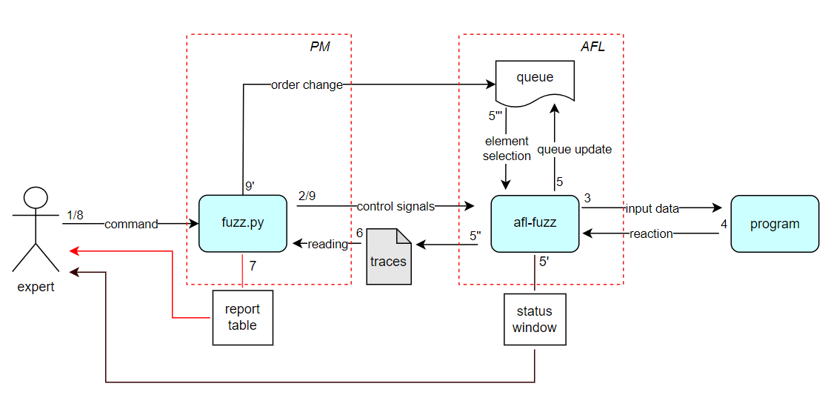

Slide 22
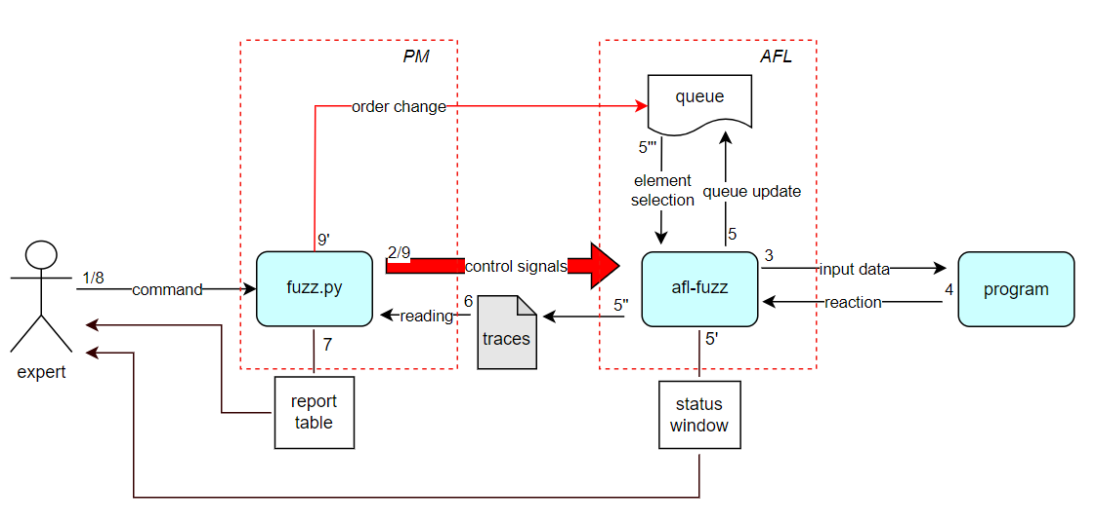

Slide 23
EXECUTION TRACE DETECTION
Prev – previous base block label;
Cur – current base block label.

Slide 24
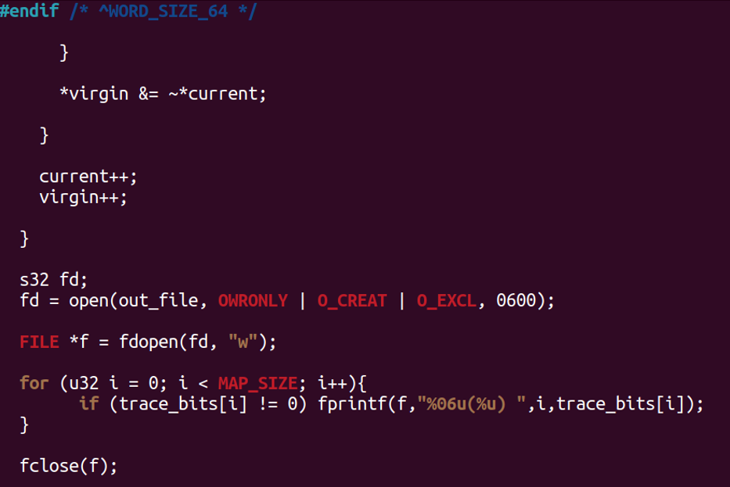
EXECUTION TRACE DETECTION

Slide 25
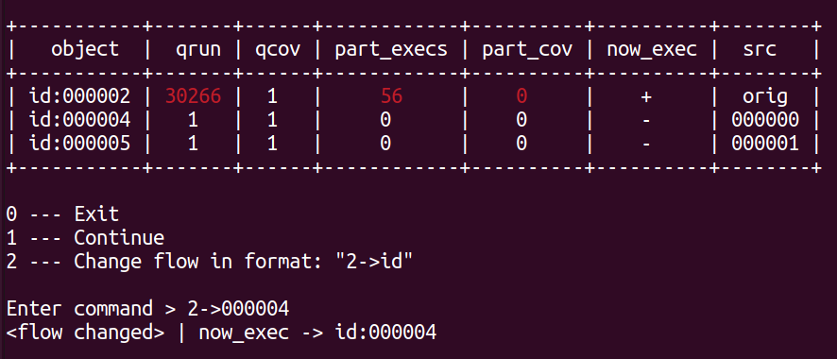
REPORT TABLE

Slide 26
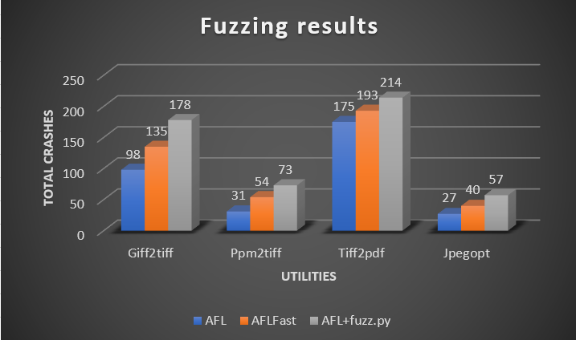

FUZZING RESULTS
$$T_{RT}=30 min \\ T_{f}=12 h$$

Slide 27
FUTURE PLANS
To consider the scheme of using the proposed solution with static analyzers
To add visualization module
Machine learning elements usage
To consider the approach in schemes based on other fuzzing tools

Slide 28

THANK YOU FOR YOUR ATTENTION

